Slide 1
Battle of Neighbourhoods
Choosing the Best Location for a Bakery in Toronto

Slide 2
INTRODUCTION
the purpose of this project is to provide enough information for someone who would like to open up a bakery in the city of Toronto. The idea is to help someone make a smart and efficient decision on selecting a great location for starting a bakery in Toronto. Fast forward in time, this will help the owner of the bakery to feel he/she made the right decision and hopefully have the bakery bringing in more customers year on year, and simultaneously growing the business over time.

Slide 3
METHODOLOGY
Collect the Toronto city data from https://en.wikipedia.org/wiki/List_of_postal_codes_of_Canada:_M.
Using Foursquare API, we will find all venues for each neighbourhood. Also using credentials of Foursquare API features of near-by places of the neighbourhoods would be mined. Due to http request limitations the number of places per neighbourhood parameter would reasonably be set to 100 and the radius parameter would be set to 700.
Filter out all venues that are bakeries.
Find ratings, and the number of bakeries found in each neighbourhood using Foursquare API.
We use the rating to Using rating for each restaurant, we will sort that data.
Visualize the Ranking of neighbourhoods using folium library(python). This can determine where will there be competition and which all neighbourhoods will have potential to start a bakery.

Slide 4
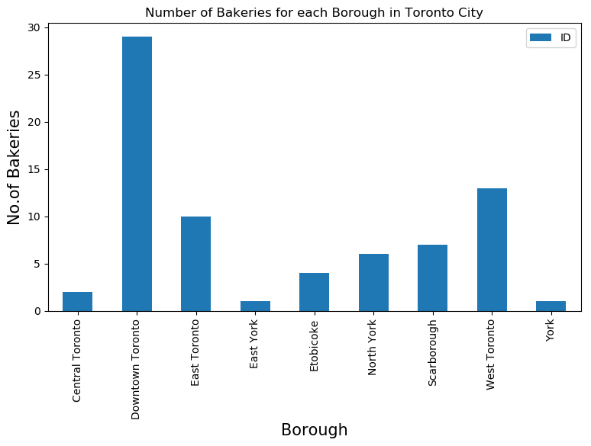
Number of Bakeries for each Borough in Toronto City:

Slide 5
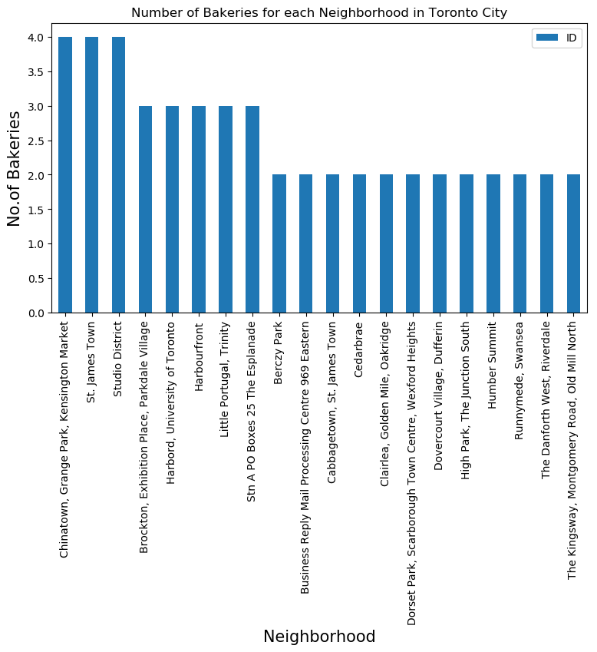
Number of Bakeries for each Neighbourhood in Toronto City:

Slide 6
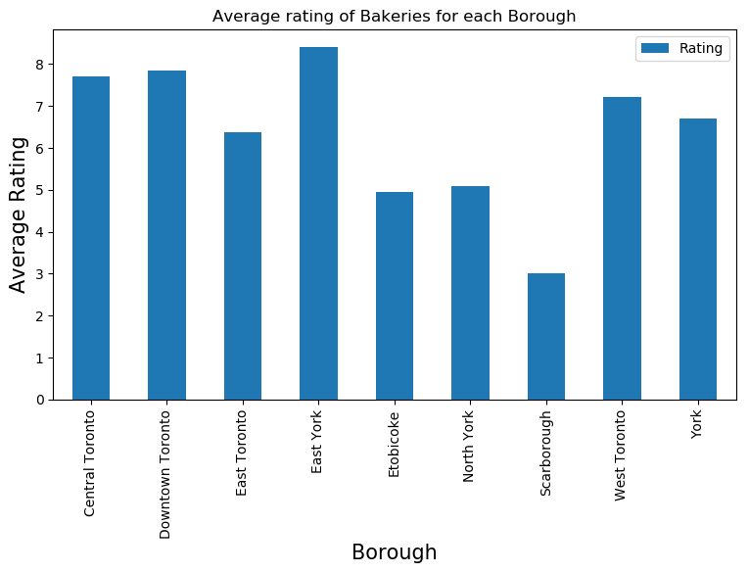
Average rating of Bakeries for each Borough

Slide 7
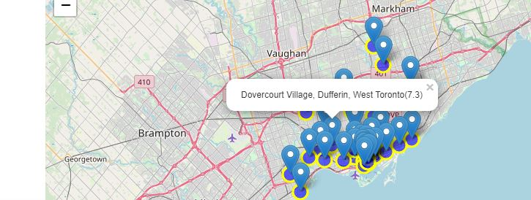
Map to visualize the Neighbourhood and borough with the average
rating of the bakery

Slide 8
DISCUSSION
The purpose of this project was to provide enough information for someone who would like to open a bakery in the city of Toronto. The idea was to help someone make a smart and efficient decision on selecting a great location for starting a bakery in Toronto.
It showed that Downtown Toronto had the greatest number of bakeries in Toronto, which was close to 30 bakeries. East York showed highest average rating, in terms of great bakeries to go to. As a recommendation it is best to start a bakery shop at East York, because it has the least number of bakeries in the Borough and it has one of the best ratings among the Boroughs

Slide 9
CONCLUSION
In this project, we used charts to visualize the average ratings that can be used to determine where a bakery can be located when starting a business.
I feel rewarded with the efforts and believe this course with all the topics covered is well worthy of appreciation. This project has shown me a practical application to resolve a real situation that has impacting personal and financial impact using Data Science tools. The mapping with Folium is a very powerful technique to consolidate information and make the analysis and decision better with confidence.

